Slide 1

MET 451: Aviation Meteorology
(3 Credit Hours)
Jeffrey N. A. Aryee (PhD)
Meteorology & Climate Science Programme
Department of Physics, KNUST, Ghana
e-mail: jeff.jay8845@gmail.com
https://github.com/jeffjay88/Aviation-Meteorology

Slide 2
Course Content
Terminologies
Aero-Meteorological Service operations
Synoptic Weather Considerations: Forecasting Fog and Low Stratus,
The Impact of Weather on Air Traffic Management, Visible and Infrared Dust Detection Techniques, Clouds and Visibility
Thunderstorms: Effects of Thunderstorms on Aircraft, Empirical Thunderstorm Forecasting Techniques
Turbulence: Effects on Aircraft, Convective Turbulence, Mechanical Turbulence, Orographic Turbulence, Clear Air Turbulence
Numerical Weather Prediction (NWP) Guidance
Icing: Introduction, Effects of Icing on Aircraft, Forecasting Aviation Icing

Slide 3
Recommended Literature
Lee, J. T., & McCarthy, J. (2014). Aeronautical meteorology. In Access Science. McGraw-Hill Education. https://doi.org/10.1036/1097-8542.013300
Proceedings of The 2017 WMO Aeronautical Meteorology Scientific Conference (AeroMetSci 2017) (6-10 November 2017; Toulouse, France)
Meteorology of Tropical West Africa; The Forecasters’ Handbook. Edited by Douglas J. Parker and Mariane Diop-Kane.

Slide 4
First Semester Highlights
October 17, 2019 - Quiz 1
November 4 – 8, 2019 - Mid-Semester Examination Week
November 11 – 16, 2019 - Mid-Semester Break
November 28, 2019 - Quiz 2
December 9 - 20, 2019 - First Semester Examinations
December 21, 2019 - End of First Semester
7 Lecture Series
7 Assignments (Given After Every Lecture Series & To Be Submitted At Start of Next Lecture or As Specified by Lecturer)
2 Quizzes

Slide 5
LECTURE 1

Slide 6


Meteorology ???
the science of the atmosphere with primal focus on weather processes and forecasting.
the science of "things in the air“, which include phenomena that are bound by the atmosphere: temperature, air pressure, water vapor, as well as their interaction and spatiotemporal changes.
is a sub-discipline of the atmospheric sciences which deals with chemistry of the atmosphere, the physics of the atmosphere, and weather forecasting.
Meteorology is a physical science -- a branch of natural science that tries to explain and predict nature's behavior based on empirical evidence, or observation.
Aviation Meteorology ???
… meteorology related to the aviation industry, their navigation and operations.

Slide 7
Aviation Meteorology is useful for the day-to-day operations and dependencies of the aviation industry.
Class Discussion
How does aviation meteorology impact on the operations of the aviation industry?

Slide 8
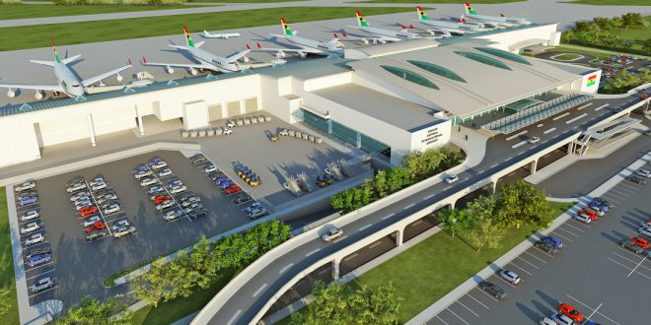
Some Basic Terminologies
Aerodrome: A defined area on land or water (including any buildings, installations and equipment) intended to be used either wholly or in part for the arrival, departure and surface movement of aircraft.
Aerodrome climatological summary: Concise summary of specified meteorological elements at an aerodrome, based on statistical data.
Aerodrome climatological table: Table providing statistical data on the observed occurrence of one or more meteorological elements at an aerodrome.
Aerodrome elevation: The elevation of the highest point of the landing area.
Aerodrome reference point: The designated geographical location of an aerodrome.
MET451: AVIATION METEOROLOGY

Slide 9
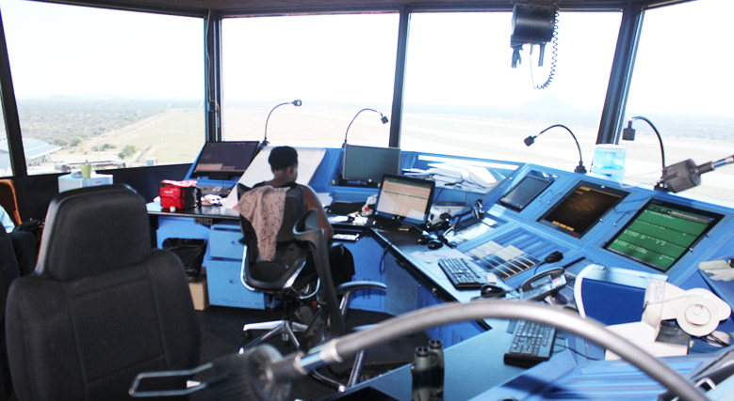

Aerodrome control tower: A unit established to provide air traffic control service to aerodrome traffic.
Air traffic services unit: A generic term meaning variously, air traffic control unit, flight information centre or air traffic services reporting office.
Aerodrome meteorological office: An office, located at an aerodrome, designated to provide meteorological service for air navigation.
Flight documentation: Written or printed documents, including charts or forms, containing meteorological information for a flight.
Briefing: Oral commentary on existing and/or expected meteorological conditions.

Slide 10
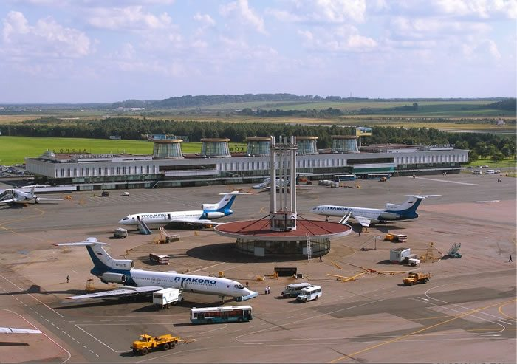
Alternate aerodrome: An aerodrome to which an aircraft may proceed when it becomes either impossible or inadvisable to land at the aerodrome of intended landing. Alternate aerodromes include the following:
Take-off alternate: An alternate aerodrome at which an aircraft can land shall this become necessary shortly after take-off and it is not possible to use the aerodrome of departure.
En-route alternate: An aerodrome at which an aircraft would be able to land after experiencing an abnormal or emergency condition while en route.
Destination alternate: An alternate aerodrome to which an aircraft may proceed shall it become impossible or inadvisable to land at the aerodrome of intended landing.
Altitude: The vertical distance of a level or an object from mean sea level (MSL).
Aeronautical meteorological station: A station designated to make observations and meteorological reports for use in air navigation.

Slide 11
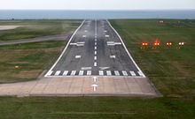
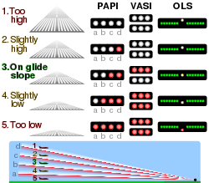
Approach control unit: A unit established to provide air traffic control service to controlled flights arriving at, or departing from, one or more aerodromes.
Control area: A controlled airspace extending upwards from a specified limit above the earth.
Cruising level: A level maintained during a significant portion of a flight.
Tarmac Delay/ Hold: The holding of an aircraft on the ground either before departure or after landing with no opportunity for its passengers to deplane.
Precision approach path indicator (PAPI) is a visual aid that provides guidance information for pilots to acquire and maintain the correct approach (in the vertical plane) to an aerodrome. It is generally located on the left-hand side of the runway approximately 300 meters beyond the landing threshold of the runway.
The visual approach slope indicator (VASI) is a system of lights on the side of an airport runway threshold that provides visual descent guidance information during approach.

Slide 12
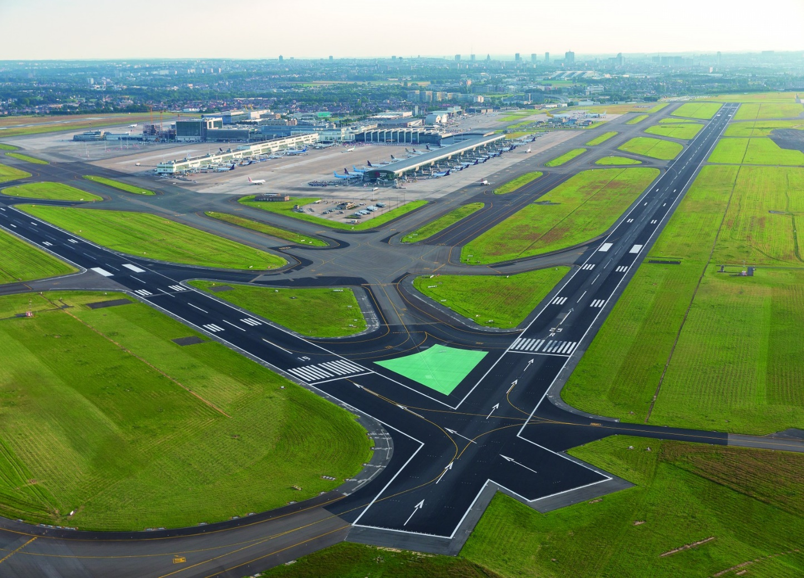
Runway: A defined rectangular area on a land aerodrome prepared for the landing and take-off of aircraft.
Runway visual range (RVR): The range over which the pilot of an aircraft on the centre line of a runway can see the runway surface markings or the lights delineating the runway or identifying its centre line.
SIGMET information: Information issued by a meteorological watch office concerning the occurrence or expected occurrence of specified en-route weather phenomena, which may affect the safety of aircraft operations.
Prognostic chart: A forecast of a specified meteorological element(s) for a specified time or period and a specified surface or portion of airspace, depicted graphically on a chart.
Quality management: Coordinated activities to direct and control an organisation with regard to quality (ISO 9000).

Slide 13
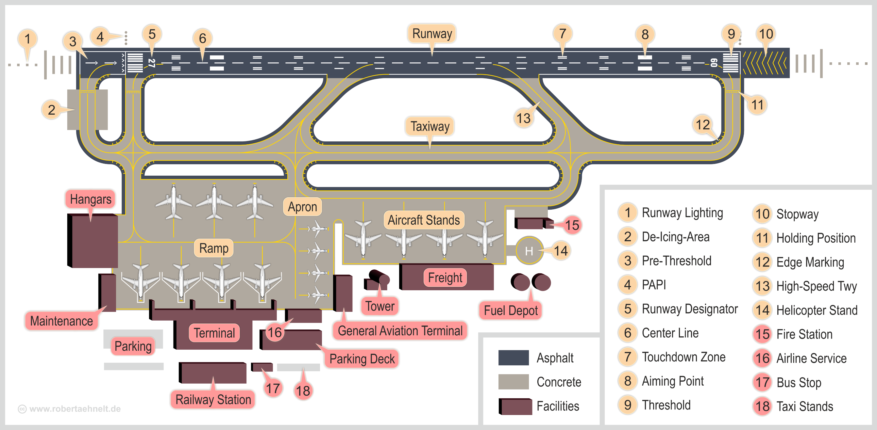
Schematic of an aerodrome
Courtesy: www.robertaehneit.de

Slide 14

Objective, determination and provision of Aero-Meteorological Service
The objective of meteorological service for international air navigation shall be to contribute towards the safety, regularity and efficiency of international air navigation.
This objective shall be achieved by supplying the following users: operators, flight crew members, air traffic services units, search and rescue services units, airport managements and others concerned with the conduct or development of international air navigation, with the meteorological information necessary for the performance of their respective functions.

Slide 15

Objective, determination and provision of Aero-Meteorological Service
Each Contracting State shall determine the meteorological service which it will provide to meet the needs of international air navigation over international waters and other areas which lie outside the territory of the State concerned in accordance with the provisions of ICAO Annex 3.
Each Contracting State shall ensure that the designated meteorological authority complies with the requirements of the World Meteorological Organization in respect of qualifications and training of meteorological personnel providing service for international air navigation.

Slide 16
Most Common Causes of Plane Crashes
1. Pilot Error: Half of all plane crashes are caused by pilot error. Pilots must navigate through dangerous weather, respond to mechanical issues and execute a safe takeoff and landing. Some plane accidents occur when pilots misread equipment, misjudge weather conditions or fail to recognize mechanical errors until it’s too late.
2. Mechanical Error: The second most common cause of plane crashes is mechanical error, which accounts for about 22% of all aviation accidents. Mechanical error differs from pilot error, because when a critical system fails, the pilot may be at the mercy of the plane. Some mechanical errors occur because of a flaw in the plane’s design. Eg. The recent Ethiopian Airlines Boeing Max 767 plane crash.

Slide 17
3. Weather: Around 12% of all plane crashes are caused by weather conditions. Although flights are often grounded when weather conditions are deemed hazardous, storms, heavy winds and even fog can sneak up on pilots and air traffic controllers. Lightning strike can be especially dangerous. When lightning hits a plane, it can disable it in many ways. Aviation accidents have happened because lightning caused electrical failure.
4. Sabotage: Plane crashes that are caused by sabotage draw the most media attention, but they only account for about 9% of total plane crashes. Some sabotaged flights crash because of hijackers.
5. Other Human Error: The bulk of the remaining plane crashes, about 7%, are caused by other kinds of human errors. Some plane crashes are caused by air traffic controllers. Air traffic control mistakes have caused planes to crash into mountains, to land on occupied runways and even to collide in midair. When a plane is loaded, fueled or maintained incorrectly, that’s human error too.

Slide 18
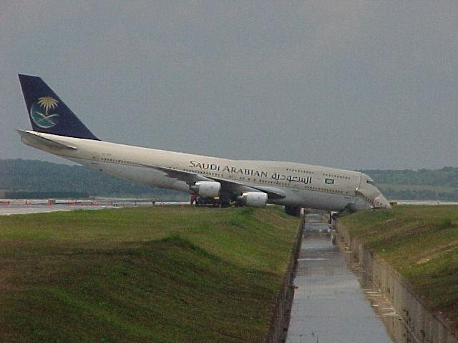
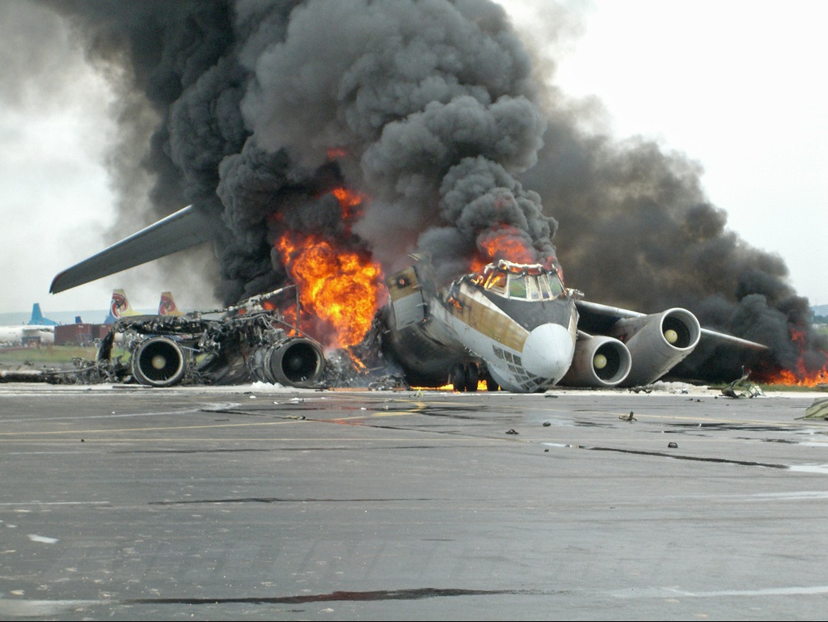
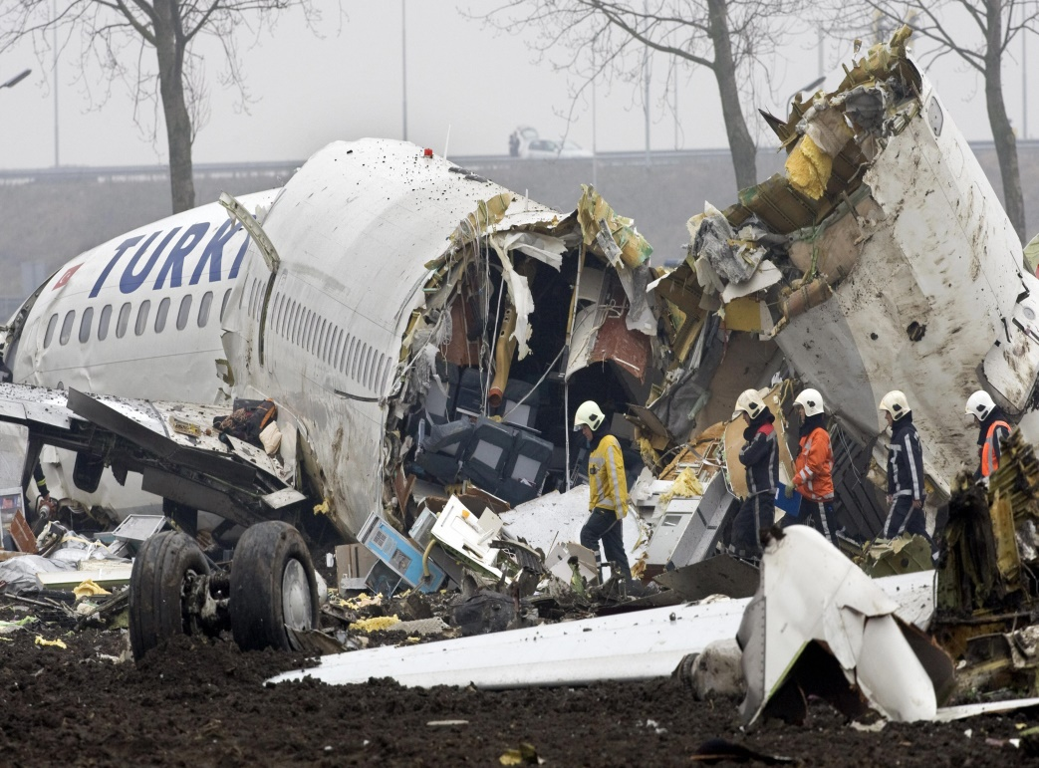
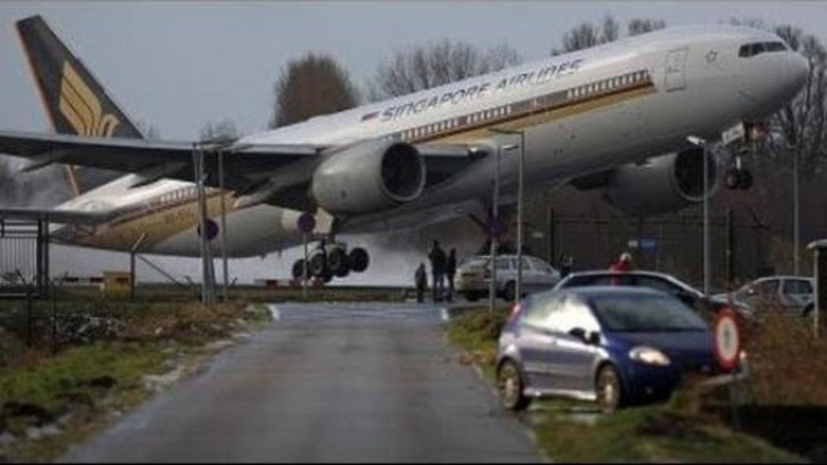
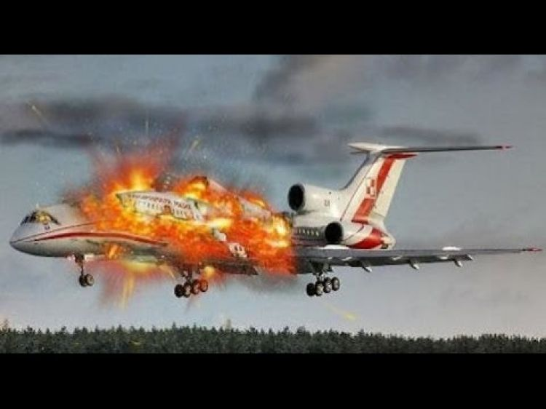

Slide 19












Operators
A person, organisation or enterprise engaged in or offering to engage in an aircraft operation.
Notifications required from operators
The meteorological authority shall be notified by the operator requiring meteorological service:
when new routes or new types of operations are planned;
when other changes, affecting the provision of meteorological service, are planned
of flight schedules
when non-scheduled flights are to be operated; and
when flights are delayed, advanced or cancelled.

Slide 20

Recommendation— The notification to the aerodrome meteorological office of individual flights should contain the following information
aerodrome of departure and estimated time of departure;
destination and estimated time of arrival;
route to be flown and estimated times of arrival at, and departure from, any intermediate aerodrome(s);
alternate aerodromes needed to complete the operational flight plan and taken from the relevant list contained in the regional air navigation plan;
cruising level;
type of flight, whether under visual or instrument flight rules;
type of meteorological information requested for a flight crew member, whether flight documentation and/or briefing or consultation; and
time(s) at which briefing, consultation and/or flight documentation are required.

Slide 21

An aerodrome meteorological office shall carry out all or some of the following functions as necessary to meet the needs of flight operations at the aerodrome:
prepare and/or obtain forecasts of local meteorological conditions
maintain a continuous survey of meteorological conditions over the aerodromes for which it is designated to prepare forecasts;
provide briefing, consultation and flight documentation to flight crew members and/or other flight operations personnel
supply other meteorological information to aeronautical users;
display the available meteorological information;
exchange meteorological information with other aerodrome meteorological offices

Slide 22
World Area Forecast Centres & System
Their objective is to supply meteorological authorities and other users with global aeronautical meteorological en-route forecasts in digital form.
(A) Prepare gridded global forecasts of
1) upper wind;
2) upper-air temperature and humidity;
3) geopotential altitude of flight levels;
4) flight level and temperature of tropopause;
5) direction, speed and flight level of maximum wind;
6) cumulonimbus clouds;
7) icing; and
8) turbulence
(B) to prepare global forecasts of significant weather (SIGWX) phenomena;
(C ) to issue the forecasts referred to in a) and b) in digital form to meteorological authorities and other users, as approved by the Contracting State on advice from the meteorological authority;

Slide 23


Slide 24
RECAP OF LECTURE 1
Fundamental Aviation Terminologies
Common causes of plane crashes
Aerodrome Meteorological Services: operations and procedures
World Area Forecast Centres and Systems

Slide 25
ASSESSMENT ON LECTURE 1
How do aprons/ramps, taxiways and runways vary from each other?
In what ways do Aeronautical meteorological stations help improve the quality of services and increase traffic for the aviation industry?
If you were piloting a commercial aircraft set for landing at the Kotoka International Airport and see any of the light indicators below on the PAPI, how would you interpret them and what do they mean for your landing?
rrrr
rrww
rrrw
wwww
rwww
(r denotes red light and w denotes white light)
Submission Deadline: October 01, 2019

